Slide 1


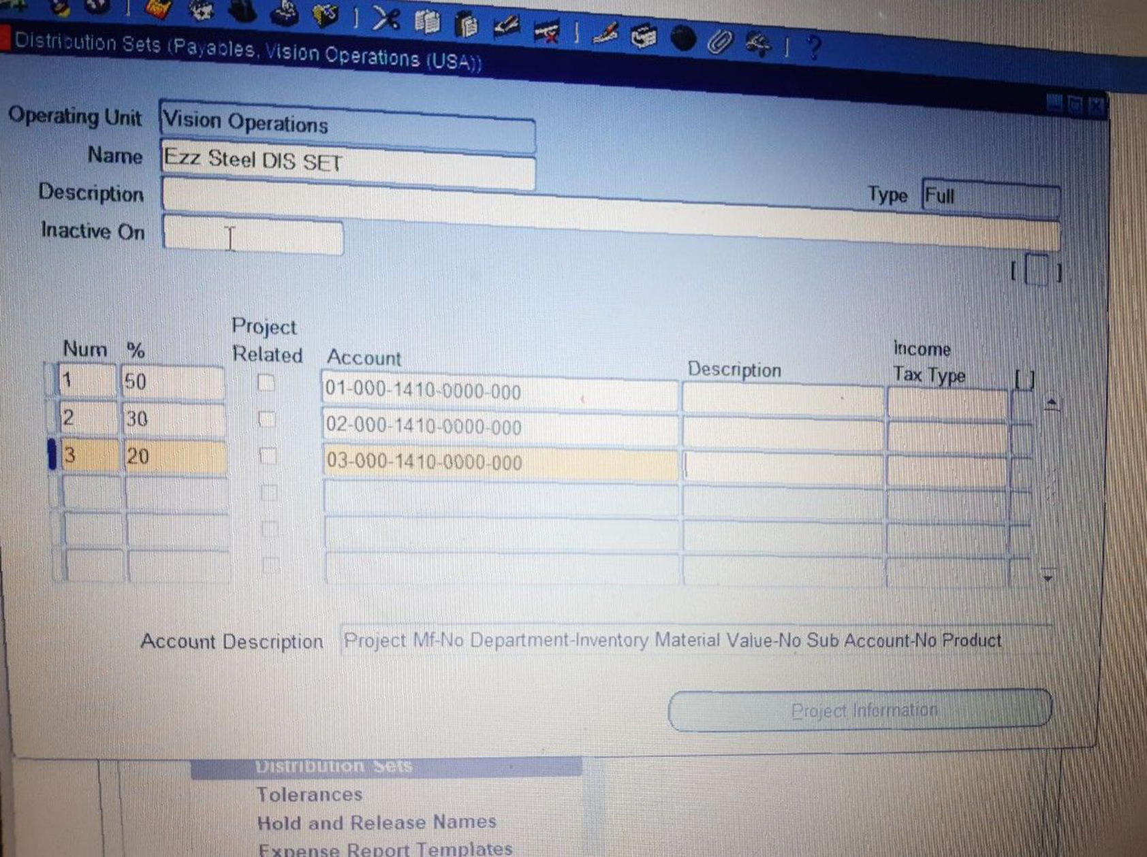
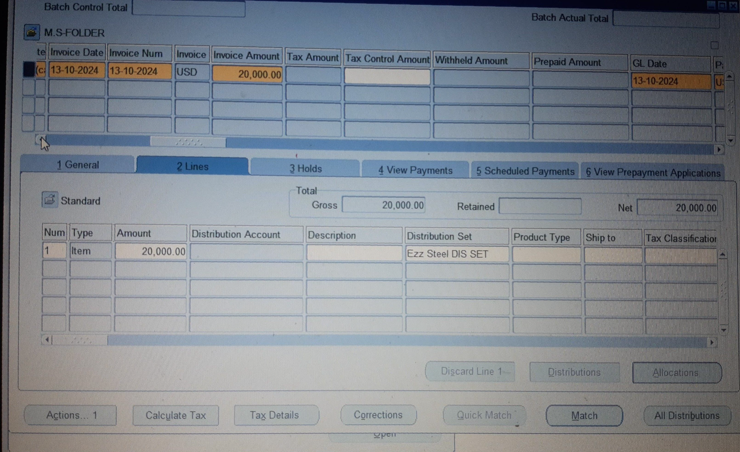
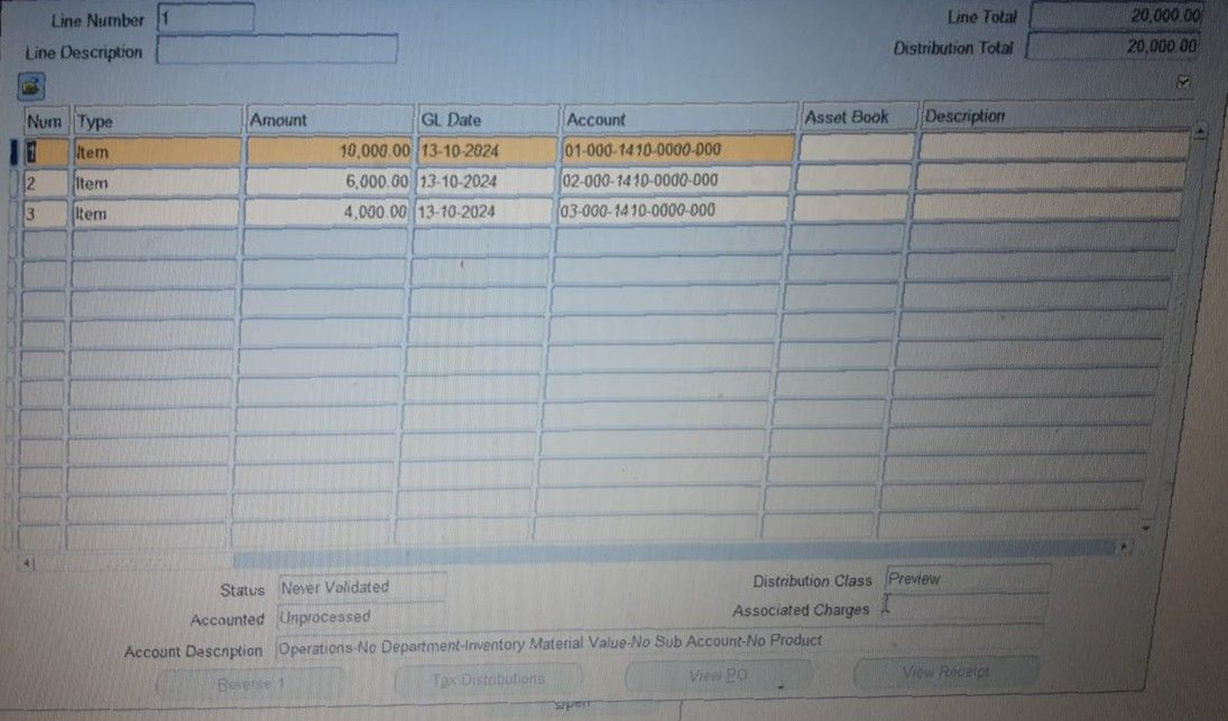
Create and Manage Supplier Invoices
Creating Invoices​
Setup >Invoice > Distribution Set
Set Name Ezz Steel DIS SET
️ Total Of % =100%
▪️ Type Full
{50% _ 30%_ 20% }
OK > Save
Distribution Set [Ezz Steel DIS SET ]
The Invoice Amount Distribution according to {50% _ 30% _ 20% }
17

